Slide 1
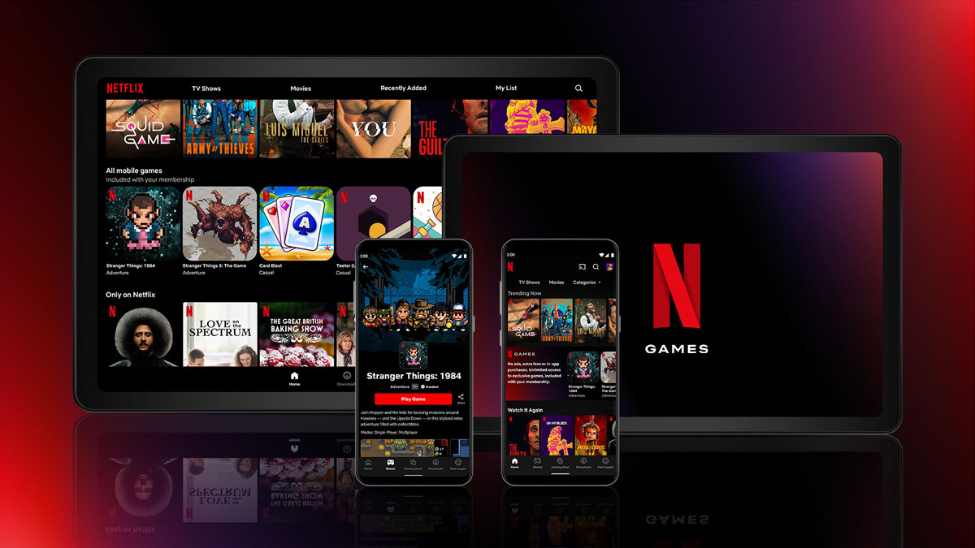
Netflix (and chill)
Ting Hao Kao Olivier Masson
April 11, 2022
1
Notes:
Pour utiliser cette diapositive d'animation de titre avec une nouvelle image, il suffit de 1) déplacer la forme semi-transparente supérieure sur le côté, 2) supprimer l'image, 3) cliquer sur l'icône de l'image pour ajouter une nouvelle image, 4) déplacer la forme semi-transparente vers la position d'origine 5) mettre à jour le texte sur la diapositive.
1

Slide 2


EXECUTIVE SUMMARY
Based on an IMDB dataset of 8451 rows and 14 columns…
We used pandas data wrangling techniques to explore and clean the Netflix dataset
We trained different classification ML models to predict 2 target variables (vote and rating) based on a selection of non correlated features
We summarized and archived our work process in Trello and GitHub
Notes:
2

Slide 3
OUR PROJECT FRAMEWORK
1
2
3
4
5
Project Initiation
Exploratory Data Analysis
Classification Models Training
Hyperparams Tuning
Key Takeaways
3
Notes:
3

Slide 4


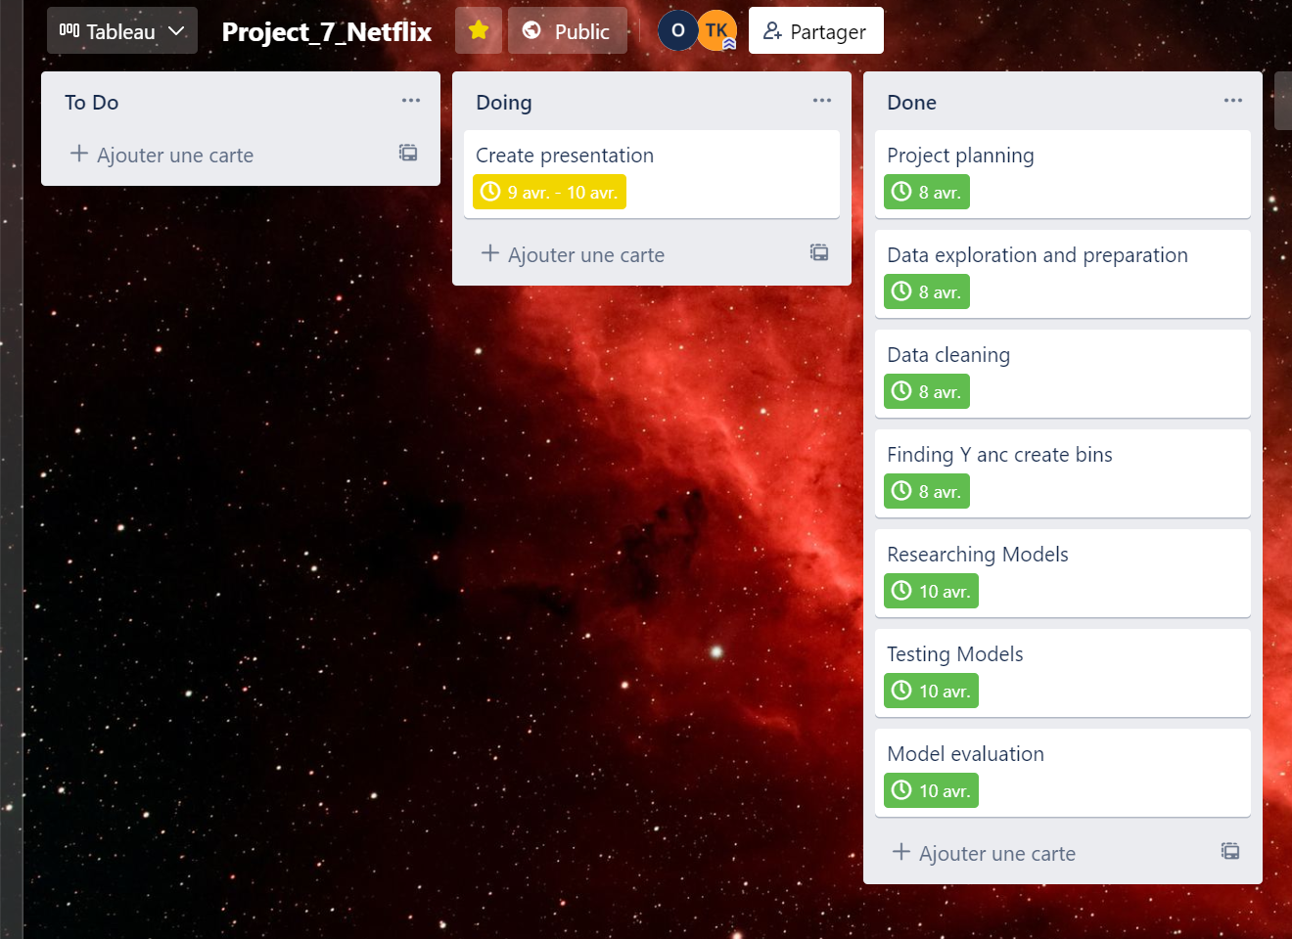
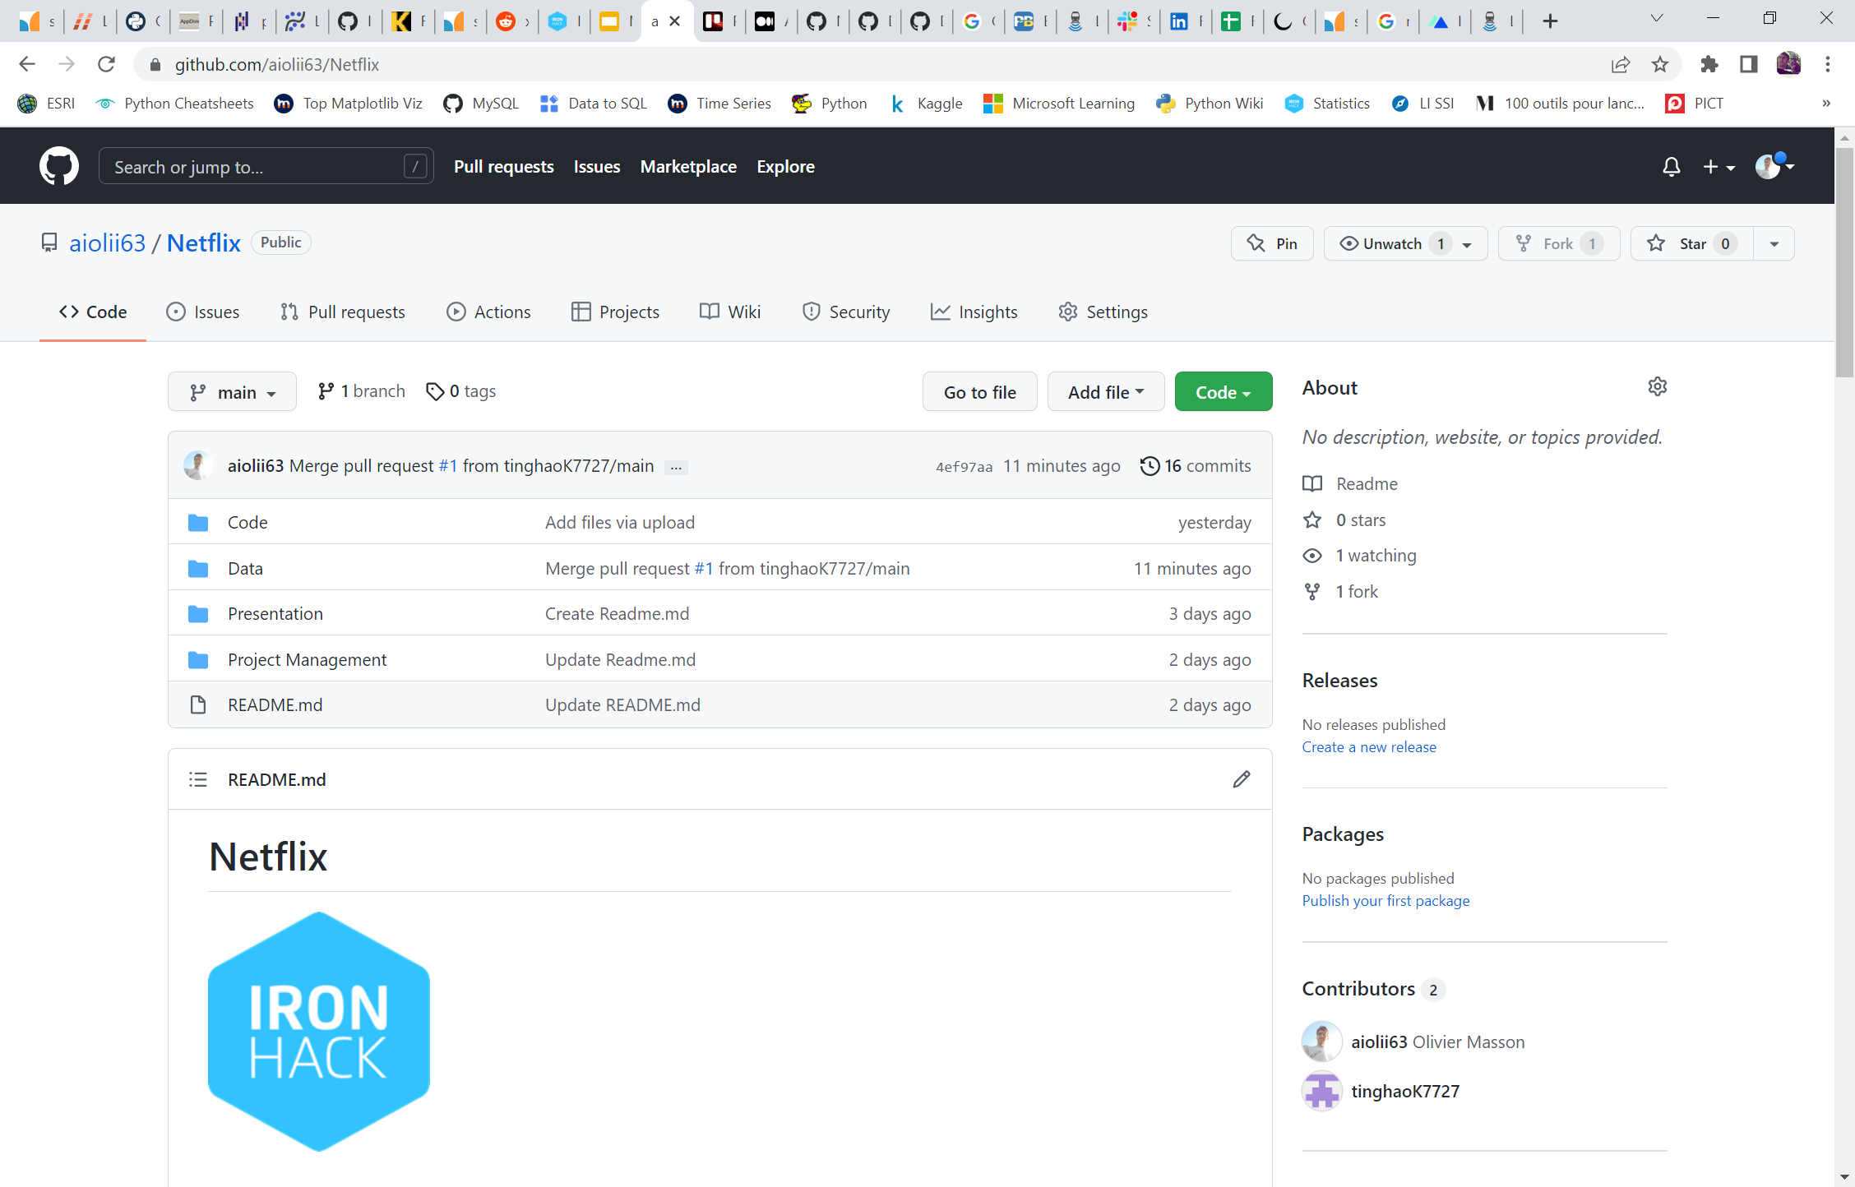
1
Project Initiation
https://trello.com/b/3jQbU0VC/project7netflix
https://github.com/aiolii63/Netflix
4
Notes:
© 2014 Microsoft Corporation. Tous droits réservés. MICROSOFT N’OFFRE AUCUNE GARANTIE, EXPRESSE, IMPLICITE OU LÉGALE CONCERNANT LES INFORMATIONS DE CETTE PRÉSENTATION.
4
08/04/2022 22:51

Slide 5
OUR PROJECT FRAMEWORK
1
2
3
4
5
Project Initiation
Exploratory Data Analysis
Classification Models Training
Hyperparams Tuning
Key Takeaways
5
Notes:
5

Slide 6
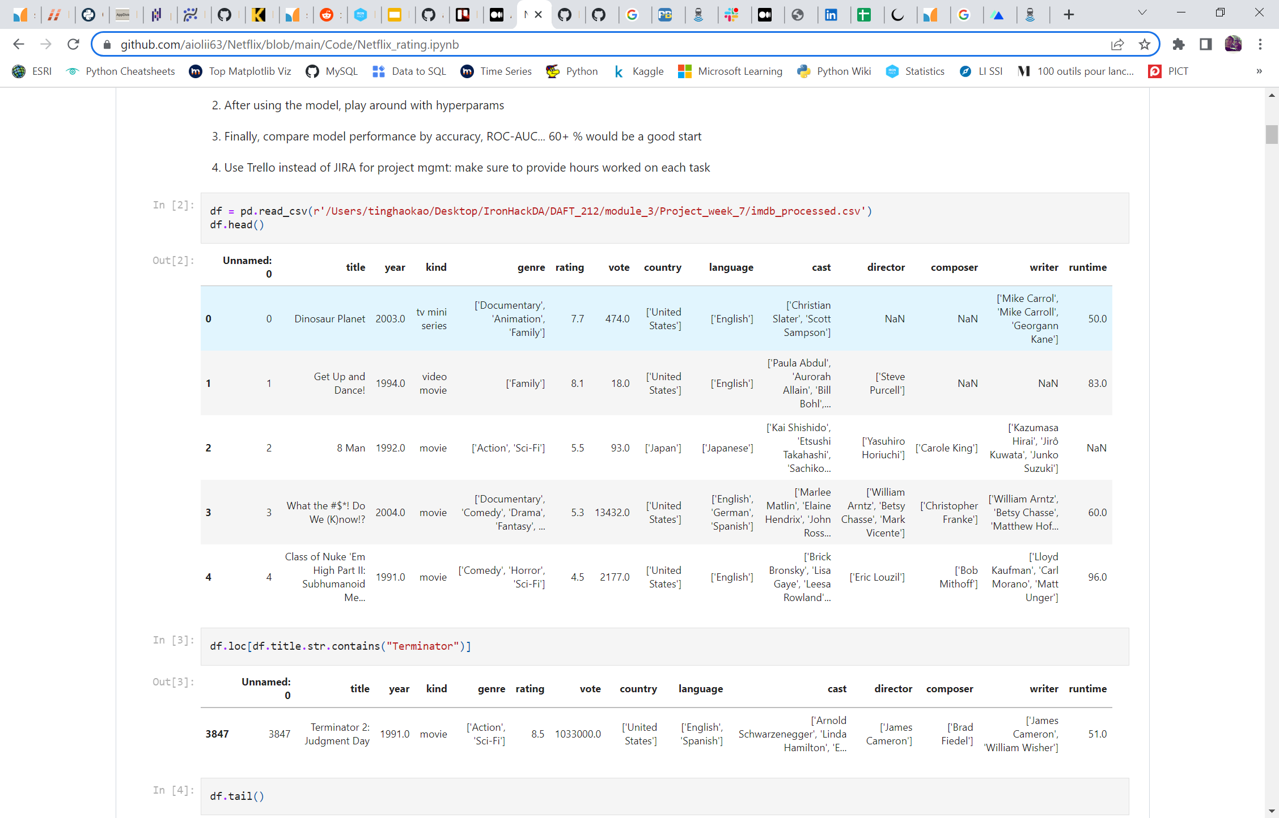
2
Data discovery
NUMERIC DATA
rating : 1 to 10
Vote : viewer vote
runtime
CATEGORICAL DATA
title
release year
kind
genre
country
language
cast
director
composer
writer
6

Slide 7
2
Our data preparation summary
BEFORE
Dataset of 8451 rows x 14 columns
Quite a large number of NaN values in some of the categorical fields
Some of the key categorical fields require splitting (genre, country, language…)
AFTER
Roughly 25% of information lost (~ 2000 rows) due to NaN cleaning
Majority of categorical fields (director, writer, cast…) left out to simplify ML model training
Binning conducted on y= vote (4 bins) and y = rating (3 bins) for simplification purposes
Encoding conducted using Label Encoder and Get Dummies
Standard Scaler processed
7

Slide 8
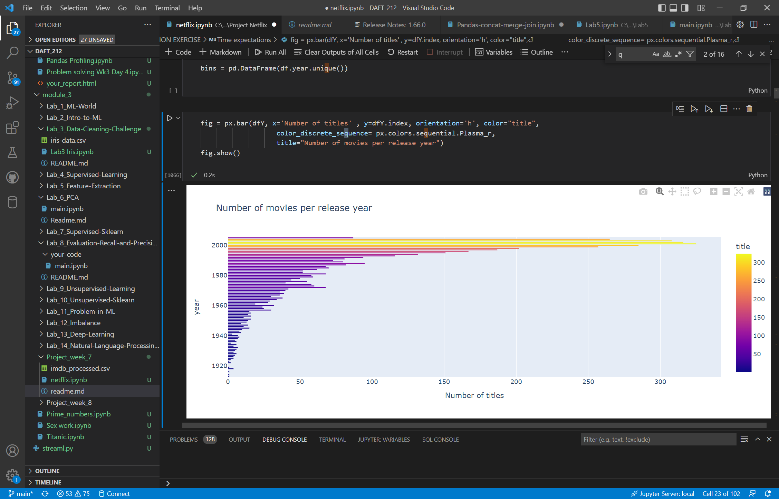
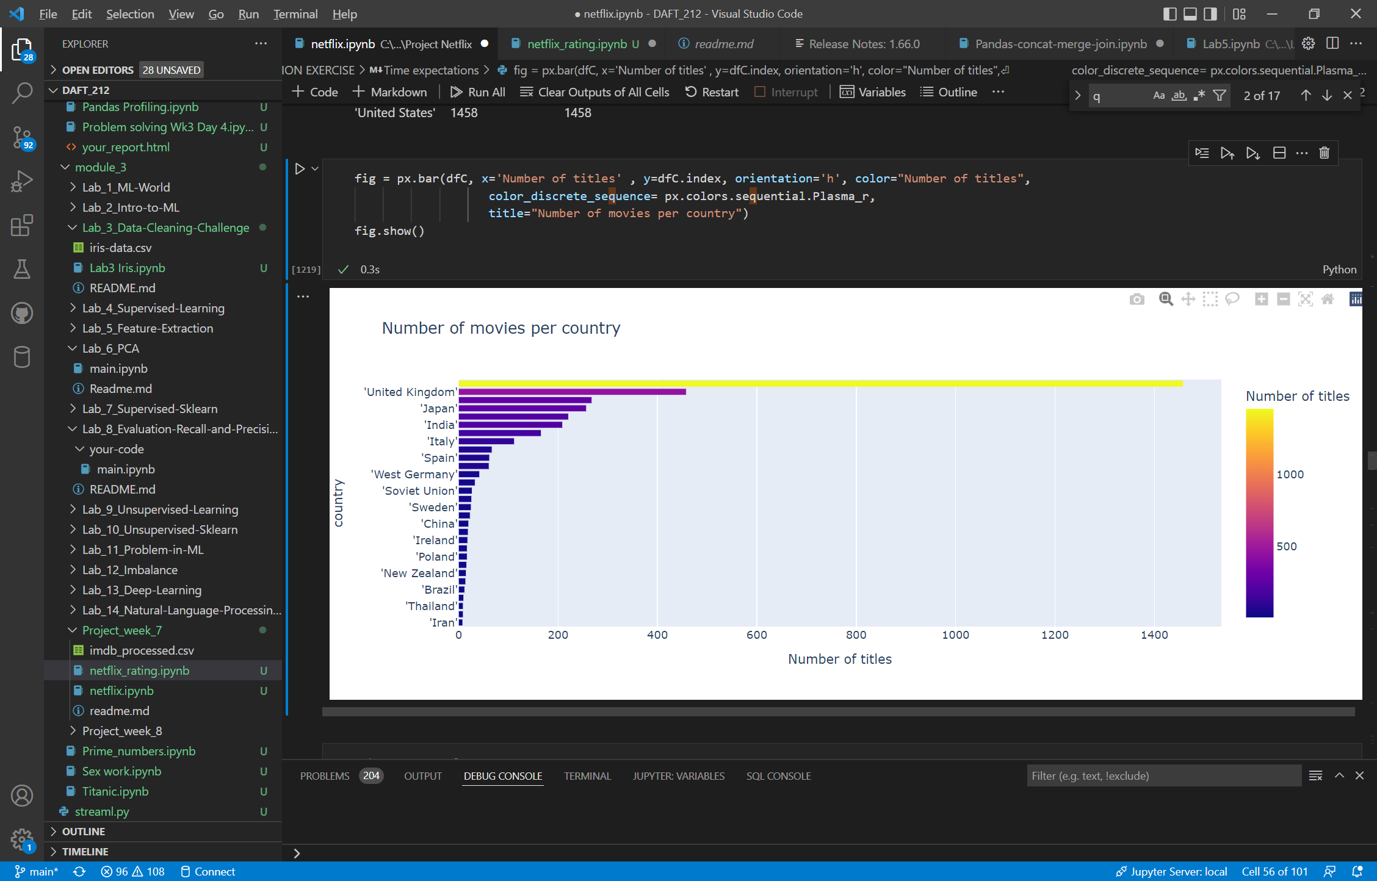
2
Key findings
NUMBER OF TITLES PER RELEASE YEAR
NUMBER OF TITLES PER COUNTRY OF ORIGIN

Slide 9
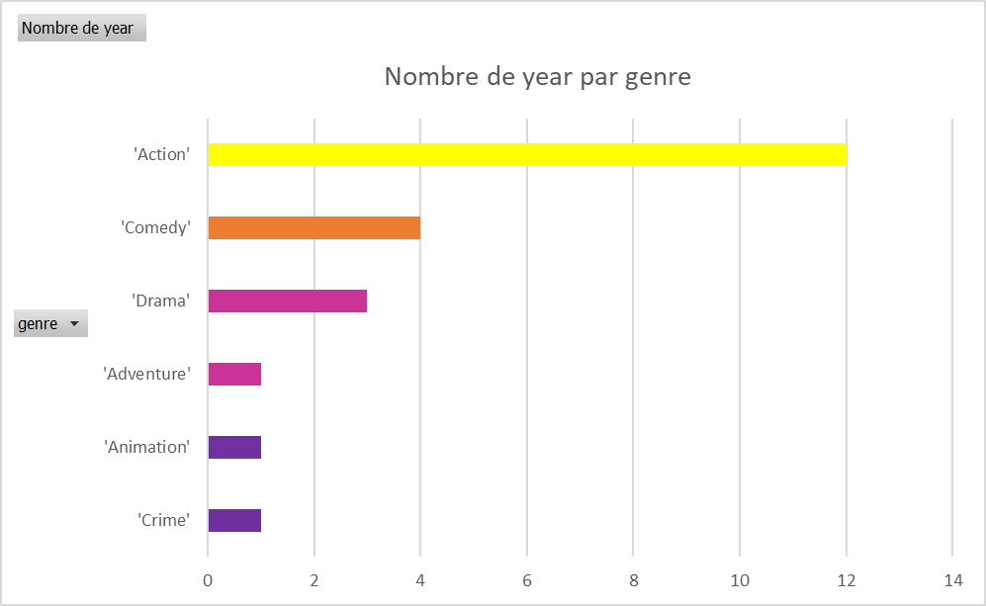
2
Key findings
MOST POPULAR GENRES PER RELEASE YEAR
MOST POPULAR GENRES PER COUNTRY

Slide 10
OUR PROJECT FRAMEWORK
1
2
3
4
5
Project Initiation
Exploratory Data Analysis
Classification Models Training
Hyperparams Tuning
Key Takeaways
10
Notes:
10

Slide 11
3
8 classification models applied to this dataset
1. Logistic Regression
2. Random Forest
3. Decision Tree
4. Linear Discriminant Analysis
5. Gaussian Process Classifier
6. Bagging Classifier
7. Gradient Boosting Classifier
8. KNN9 (for ‘vote’) and KNN15 (for ‘rating’)
11

Slide 12
3
Two models turned out better predictors than the rest
Classification with target = vote
Accuracy rate after: 55% (Random Forest)
One prediction done with Random Forest (correctly predicted)
Classification with target = rating
Accuracy rate after: 63% (Gradient Boosting Classifier)
One prediction done with Gradient Boosting Classifier (correctly predicted)

Slide 13
OUR PROJECT FRAMEWORK
1
2
3
4
5
Project Initiation
Exploratory Data Analysis
Classification Models Training
Hyperparams Tuning
Key Takeaways
13
Notes:
13

Slide 14
3
Hyperparams could not boost the predictive quality of our models
Classification with target = vote
Hypertuning with Grid Search
Classification with target = rating
Hypertuning with Random Search
No significant gain
No significant gain

Slide 15
OUR PROJECT FRAMEWORK
1
2
3
4
5
Project Initiation
Exploratory Data Analysis
Classification Models Tuning
Hyperparams Tuning
Key Takeaways
15
Notes:
15

Slide 16
5
Key Takeaways
The Netflix dataset proved somewhat small and incomplete to correctly train classification models
A couple of models proved to perform reasonably well (RFC and GBC)
Still our top performing model was only marginally better than a good old coin toss !

Slide 17
NEXT STEPS
Netflix…
…and
…chill !
Notes:
17

Slide 18

18
Notes:
Combinez une image et plusieurs instructions clés avec une grille forte.
18

